Slide 1
Cryptography
Unit-3

Slide 2
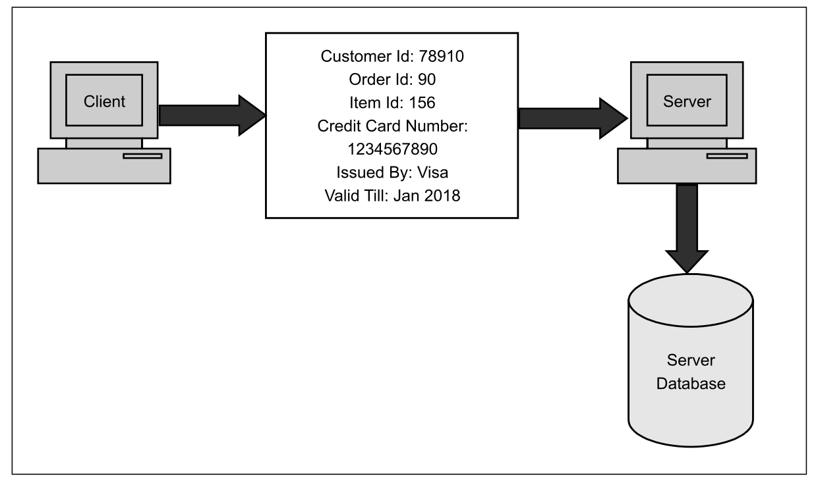
Need for Security
Earlier computers had no or a best very little security
This continued for number of years.
Need for Security realized when financial and personal data needs security and privacy.

Slide 3
Need for Security
Provide a user identification and password to every user, and use that information to authenticate a user.
Encode information stored in the databases in some fashion, so that it is not visible to users who do not have the right permission.
What are the various Security Holes?

Slide 4
Security Holes
Intruder can capture the credit card details
Merchant database can be hacked
Example: Russian attacker (maxim) managed to intrude merchant site and obtained 300,000 credit card members. Demanded protection money $100,000 from the merchant

Slide 5
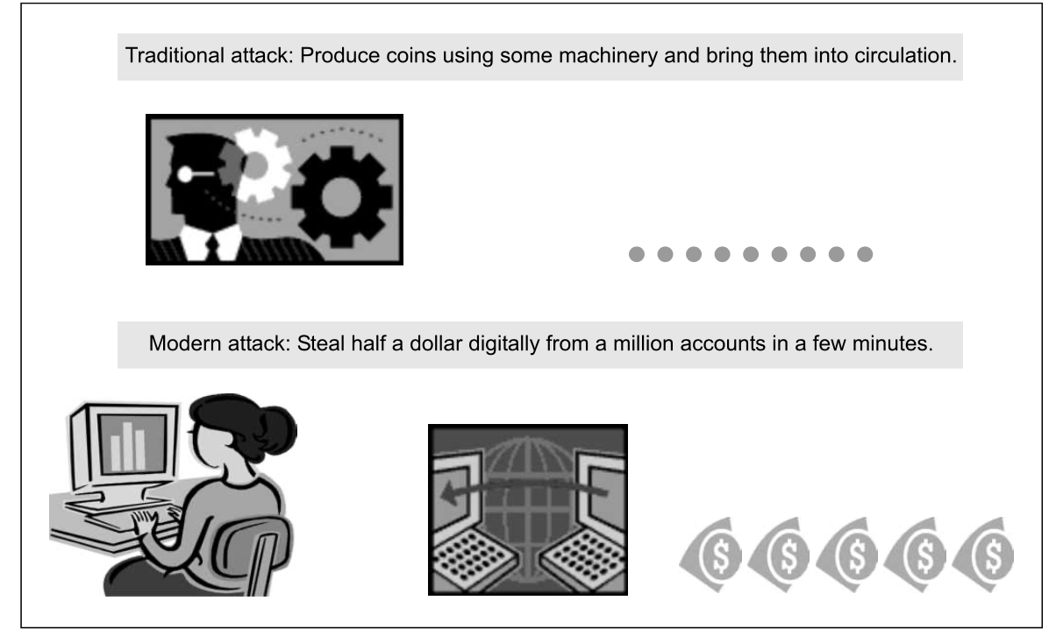
Modern Nature of Attacks
Automating attacks

Slide 6
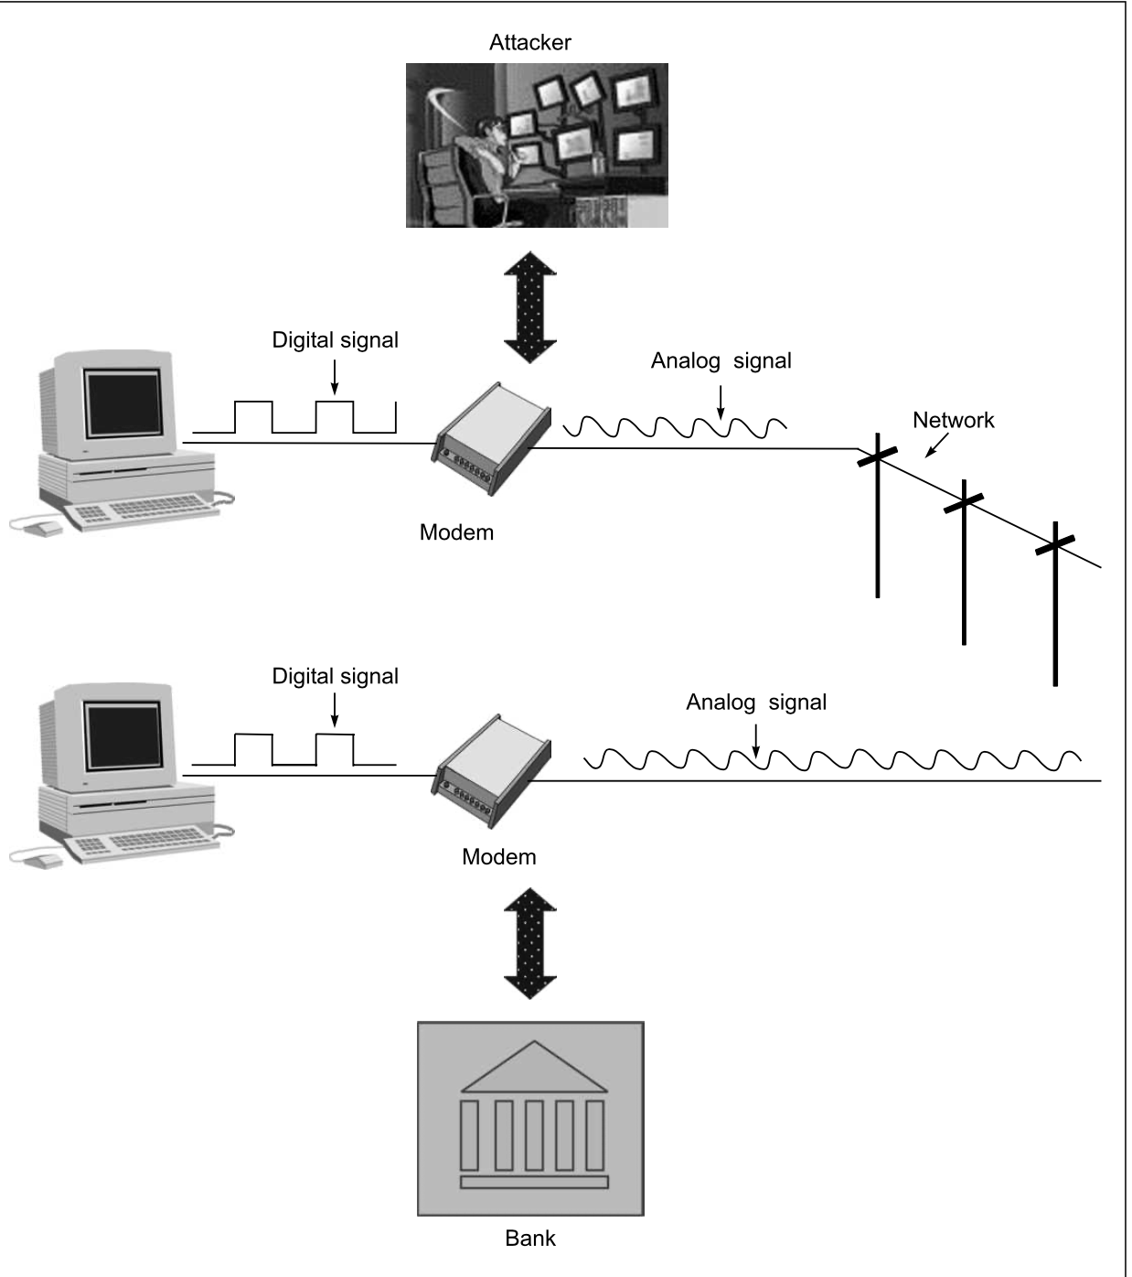
Distance does not matter

Slide 7
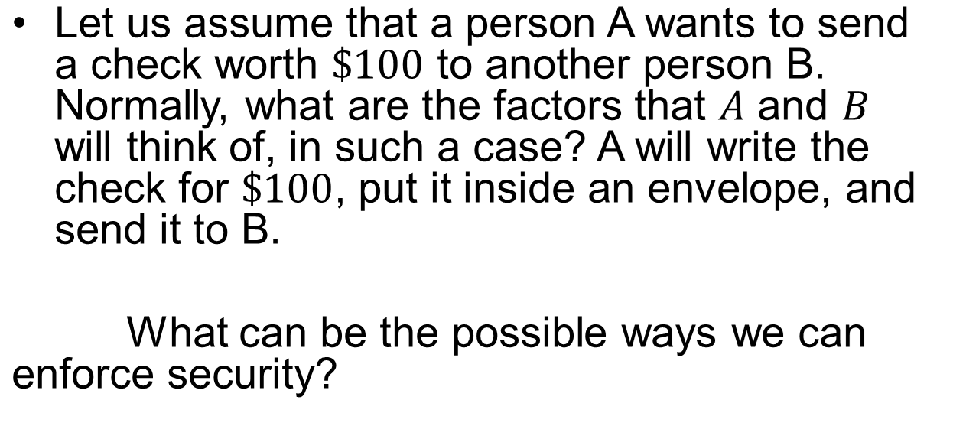
Principle of Security

Slide 8
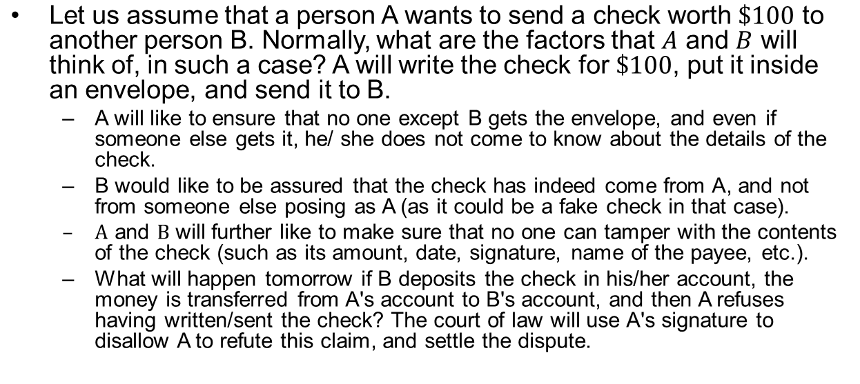
Principle of Security

Slide 9
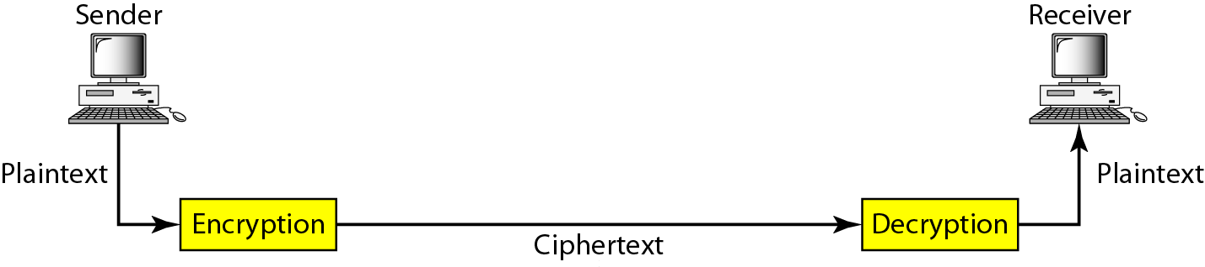
Figure 30.1 Cryptography components
30.<number>

Slide 10
Basic Terminology
plaintext - the original message
ciphertext - the coded message
cipher - algorithm for transforming plaintext to ciphertext
key - info used in cipher known only to sender/receiver
encipher (encrypt) - converting plaintext to ciphertext
decipher (decrypt) - recovering ciphertext from plaintext
cryptography - study of encryption principles/methods
cryptanalysis (codebreaking) - the study of principles/ methods of deciphering ciphertext without knowing key
cryptology - the field of both cryptography and cryptanalysis
Notes:
Briefly review some terminology used throughout the course.

Slide 11
Requirements
two requirements for secure use of symmetric encryption:
  a strong encryption algorithm
  a secret key known only to sender / receiver
  Y = E_{K}(X)
  X = D_{K}(Y)
assume encryption algorithm is known
implies a secure channel to distribute key
Notes:
Generally assume that the algorithm is known.
This allows easy distribution of s/w and h/w implementations.
Hence assume just keeping key secret is sufficient to secure encrypted messages.
Have plaintext X, ciphertext Y, key K, encryption alg Ek, decryption alg Dk.

Slide 12
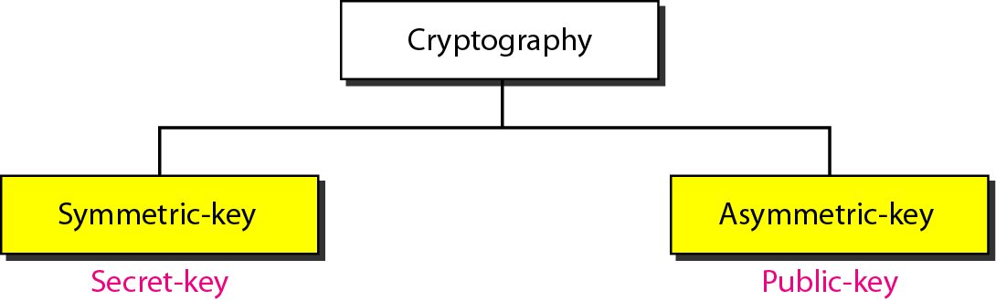
Types of encryption
Symmetric Encryption
Asymmetric Encryption

Slide 13
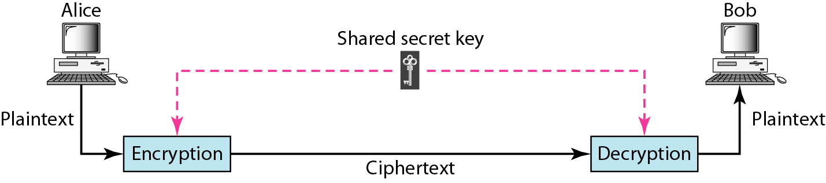
Figure 30.3 Symmetric-key cryptography
30.<number>

Slide 14
Symmetric Encryption
A systems where by knowing the algorithm and the key, you can both encrypt and decrypt a message. This kind of encryption is known as symmetric encryption.
The big advantage of this kind of encryption is that it is easy because it does not require complex math and much calculation to execute.
On the other hand, it makes critical the key exchange moment and key management. In fact, the key has to be exchanged before the transmission can start between the parties, and it has to be done securely.

Slide 15
Symmetric Encryption
As for the key management problem, since both parties know the same secret (in fact, this kind of cryptography is also called shared secret).

Slide 16
Symmetric Encryption
The types of symmetric encryption that are used are as follows:
  Stream cipher (ex, RC4) (WEP, WPA, SSL, TSL)
  Block cipher (AES, DES, 3DES)

Slide 17

Note
In symmetric-key cryptography, the same key is used by the sender
(for encryption)
and the receiver (for decryption).
The key is shared.
30.<number>

Slide 18
Cryptography
can characterize by:
  type of encryption operations used
    substitution / transposition / product
  number of keys used
    single-key or private / two-key or public
  way in which plaintext is processed
    block / stream

Slide 19
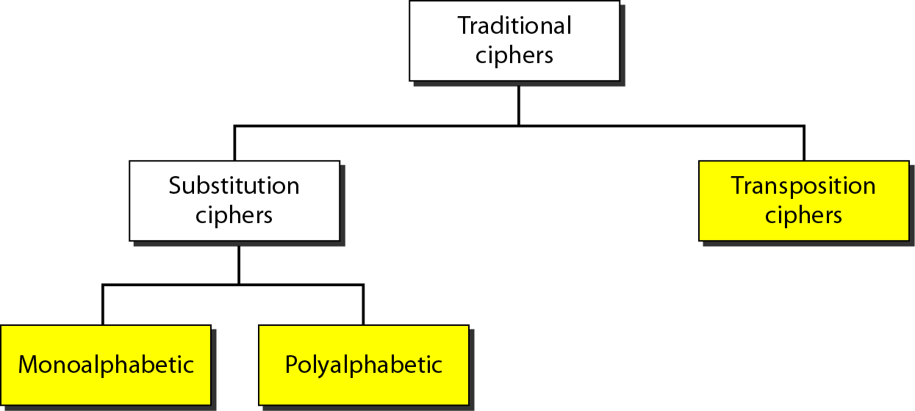
Figure 30.7 Traditional ciphers
30.<number>

Slide 20
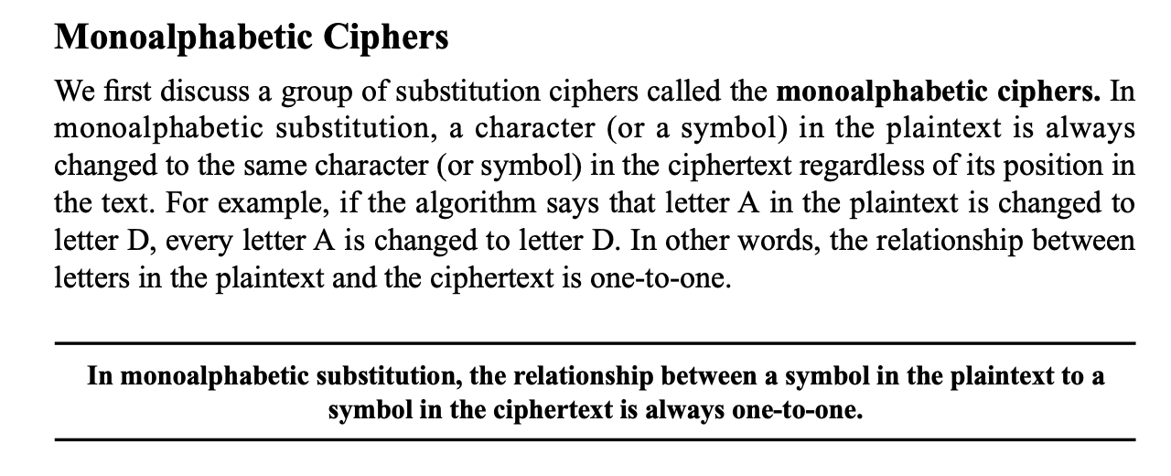

Slide 21
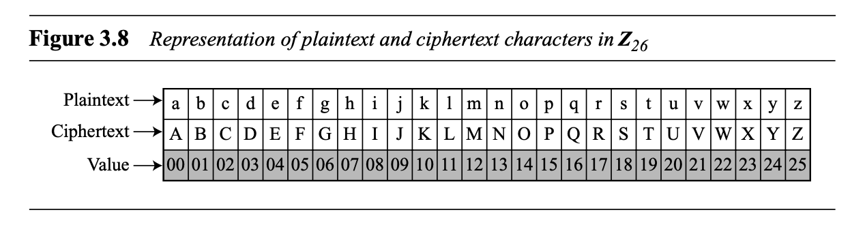

Slide 22
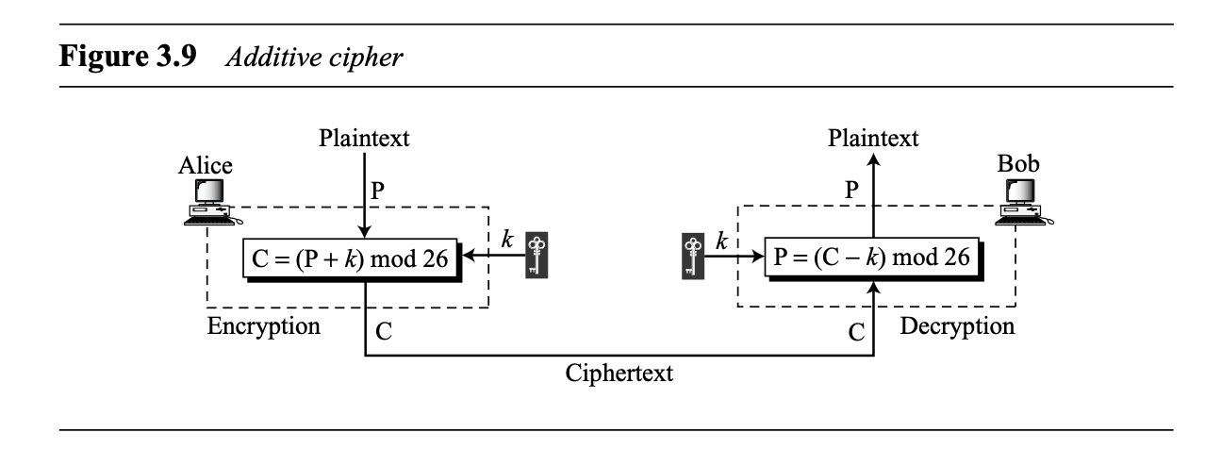
Additive Cipher/Shift Cipher/Caesar Cipher

Slide 23
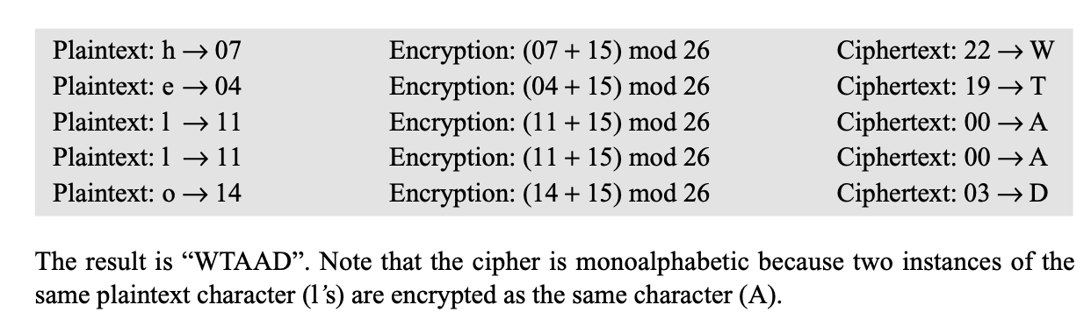

Slide 25
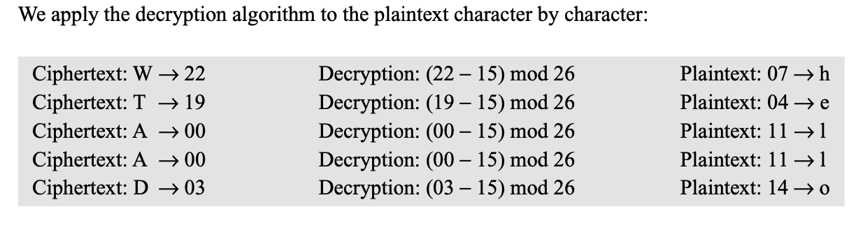

Slide 26
Note
The shift cipher is sometimes referred to as the Caesar cipher. (monoalphabetic)
30.<number>

Slide 27
CryptAnalysis
BruteForce Attack

Slide 28
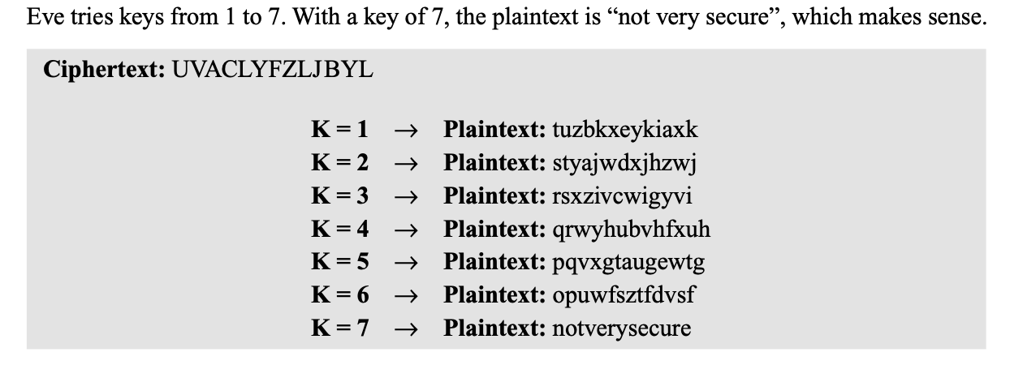

Slide 29
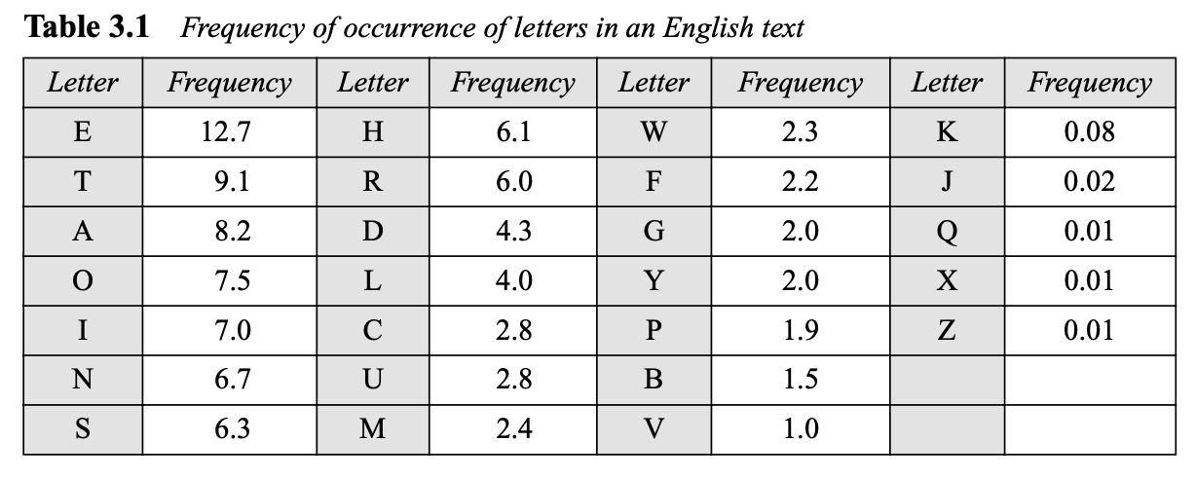
Crypt-Analysis
Statistical Attack

Slide 30
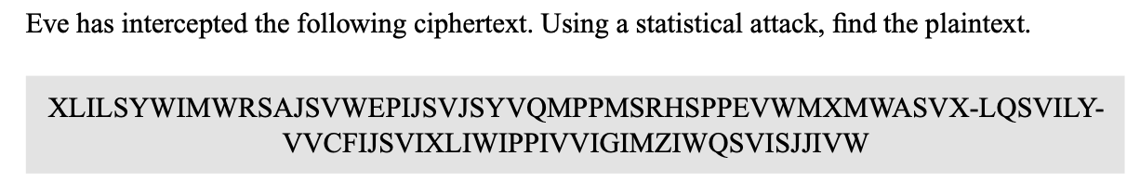

Slide 31
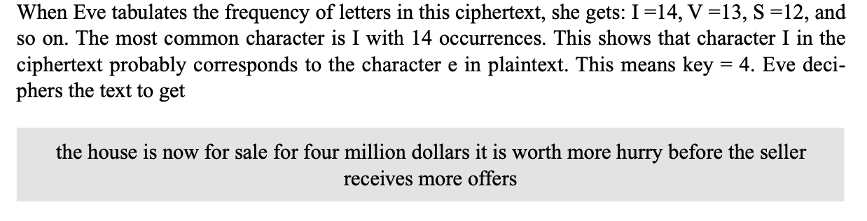

Slide 32
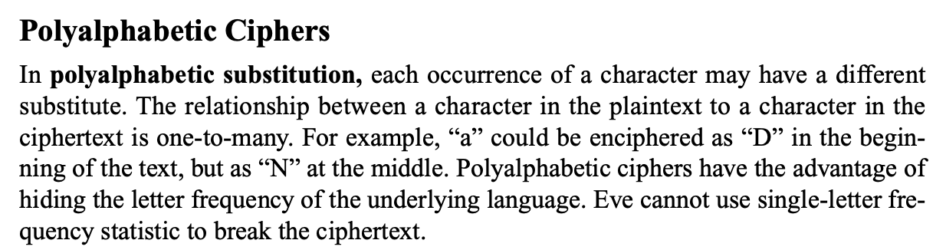
Polyalphabetic Ciphers

Slide 33
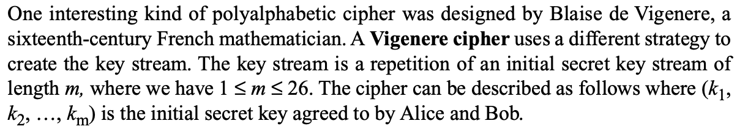
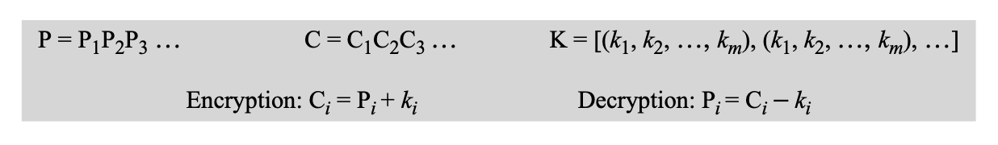
Vigenère Cipher
Notes:
Simply create a set of caesar cipher translation alphabets, then use each in turn, as shown next.

Slide 34
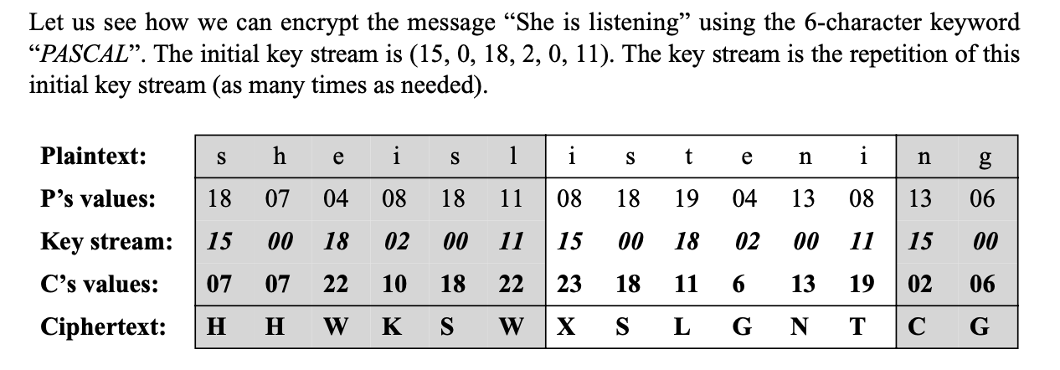

Slide 35
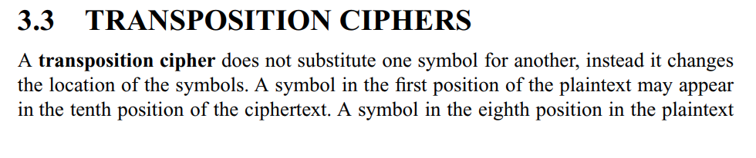
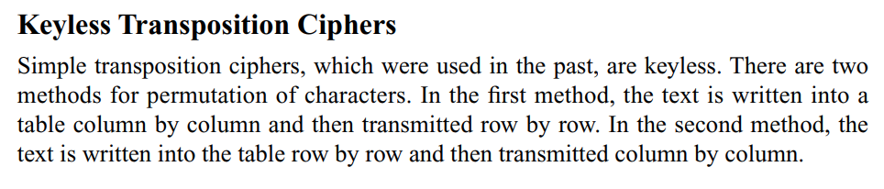
Transposition Ciphers
Notes:
Transposition Ciphers form the second basic building block of ciphers. The core idea is to rearrange the order of basic units (letters/bytes/bits) without altering their actual values.

Slide 36
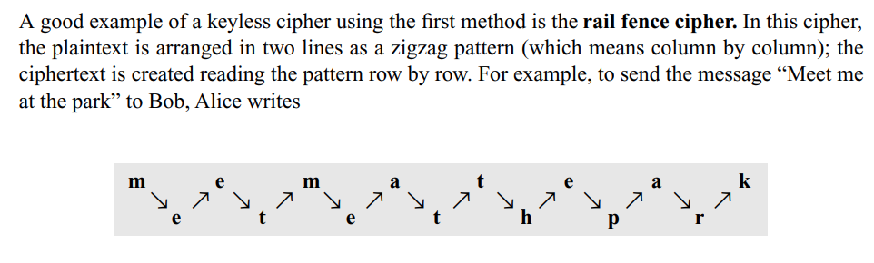

Keyless Transposition Cipher

Slide 37
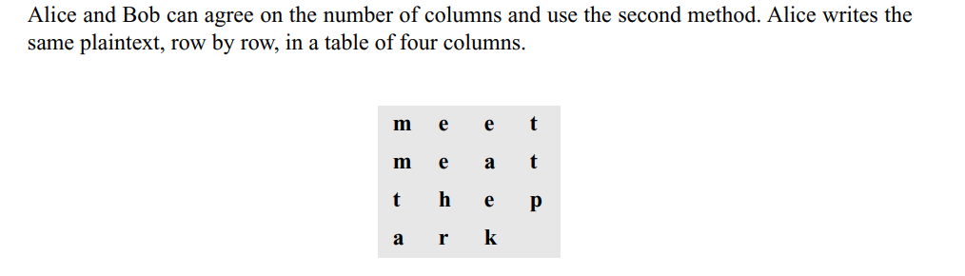

Keyless Transposition Cipher

Slide 38
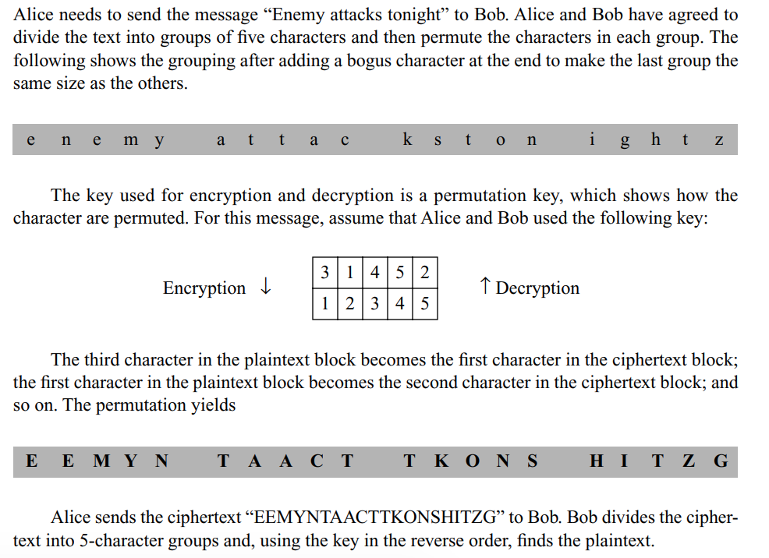
Key Transposition Cipher

Slide 39
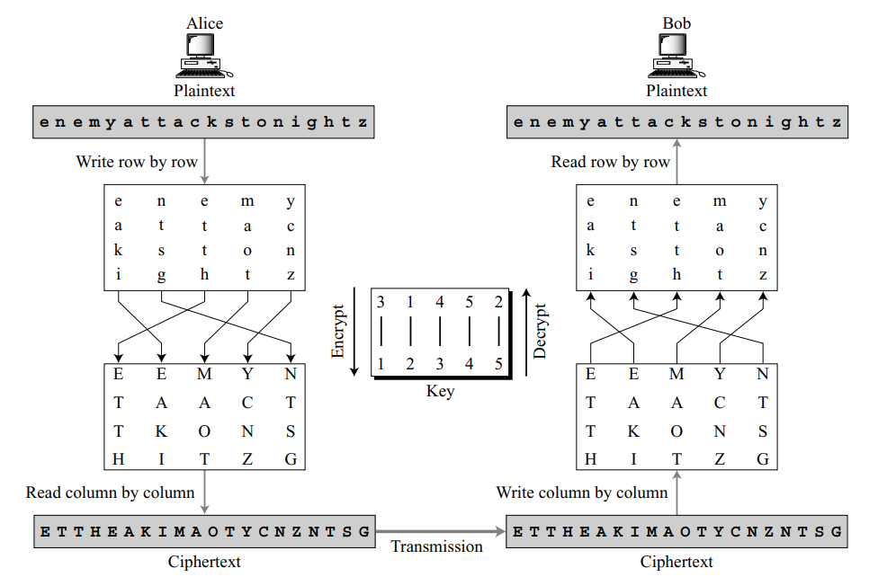
Combination Transposition Cipher

Slide 40
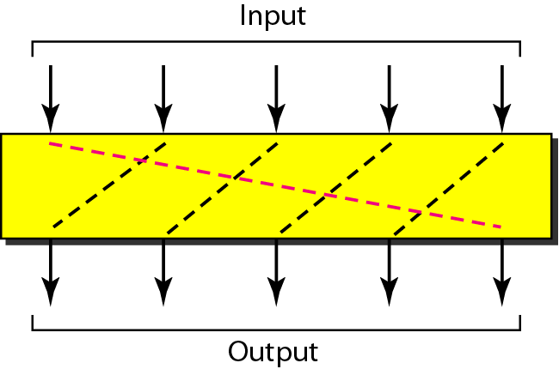
Rotation cipher
30.<number>

Slide 41
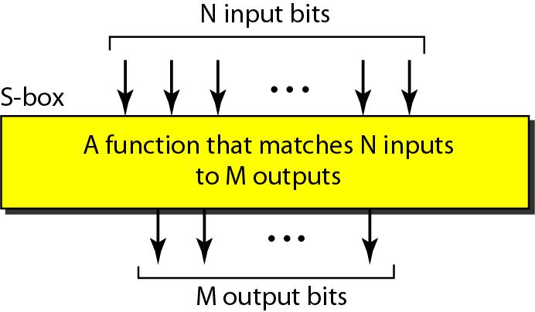
S-box (substitution box)
30.<number>

Slide 42
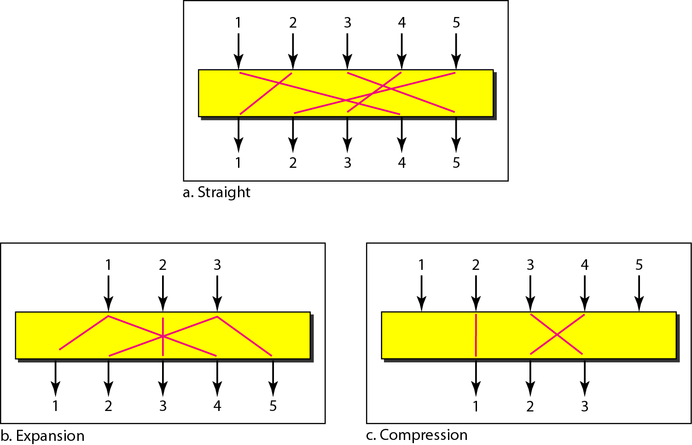
P-boxes (permutation box): straight, expansion, and compression
30.<number>

Slide 43
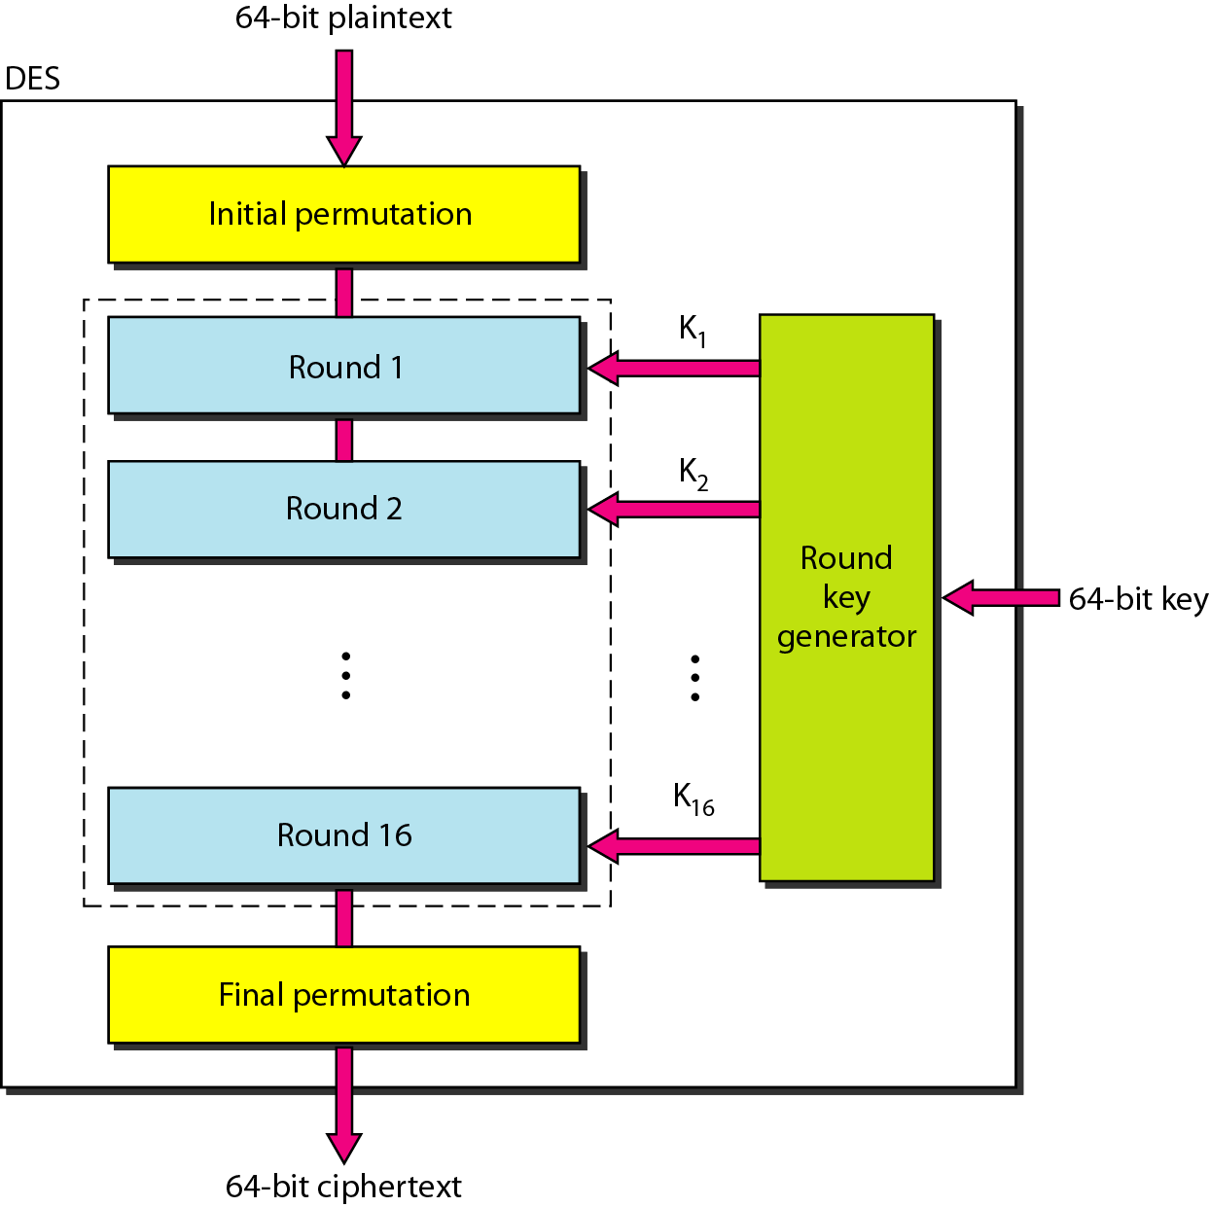
DES (Data Encryption Standard)
30.<number>

Slide 44
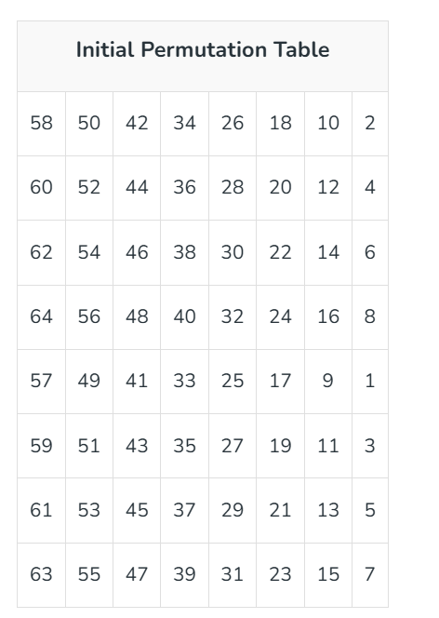

Slide 45
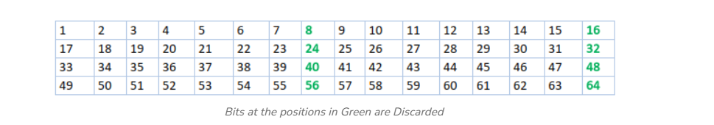

Slide 46
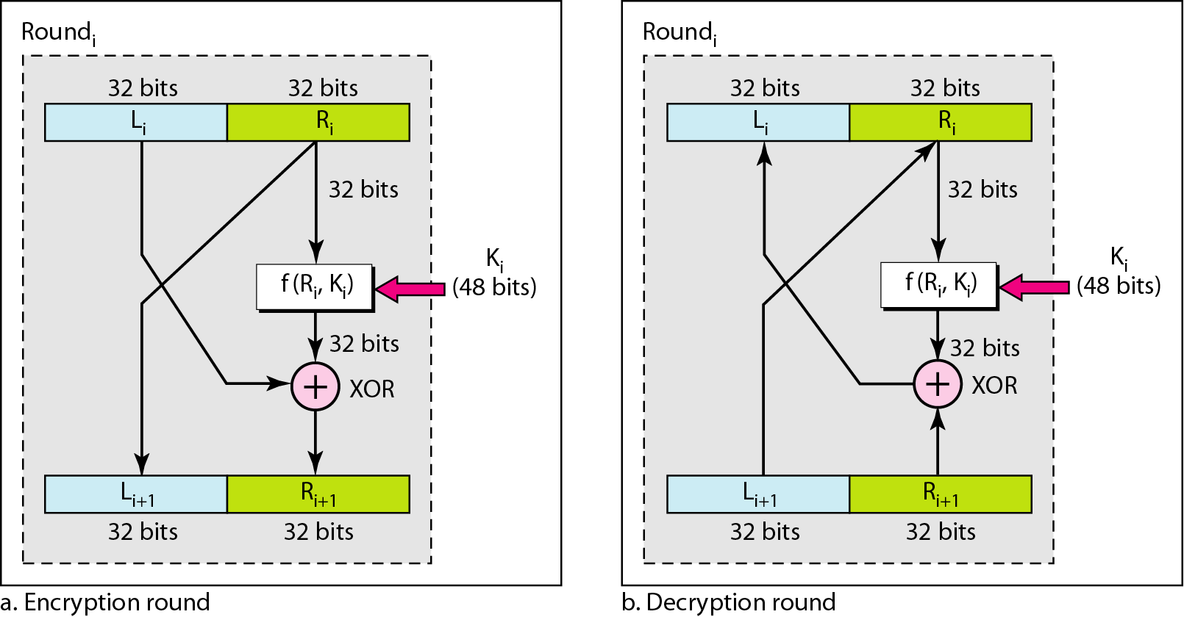
One round in DES ciphers
30.<number>

Slide 47
For each round, the Feistel function works like this:
F(R, K), where:
R = right half of the data block (32 bits)
K = round subkey (48 bits)
Steps inside the Feistel function:
Expansion (E):
  Expands the 32-bit input R to 48 bits by duplicating and rearranging certain bits.
  Purpose: To match the size of the 48-bit key.
Key Mixing (XOR):
  The 48-bit expanded data is XORed with the 48-bit round key K.
Substitution (S-boxes):
  The 48-bit result is split into eight 6-bit chunks.
  Each 6-bit chunk is passed through a different S-box (Substitution box), reducing it to 4 bits.
  Total output after S-boxes = 8 × 4 = 32 bits.
Permutation (P-box):
  The 32-bit result from the S-boxes is shuffled using a fixed permutation table to create diffusion.

Slide 48
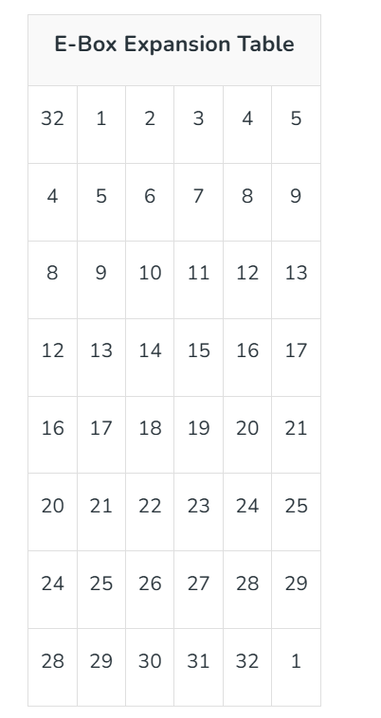

Slide 49
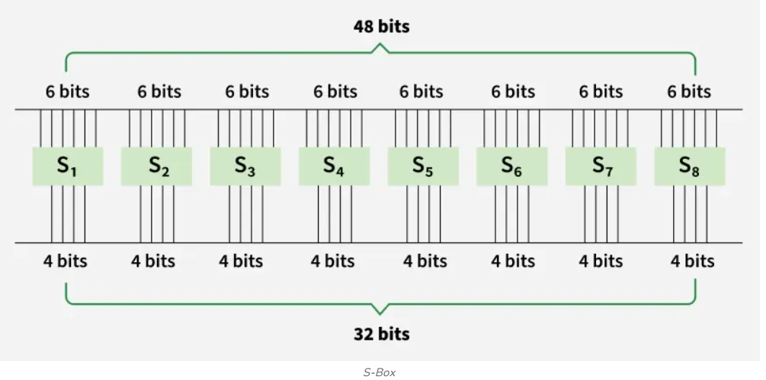

Slide 50
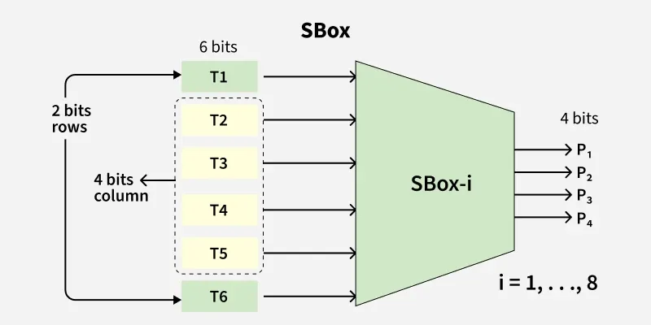
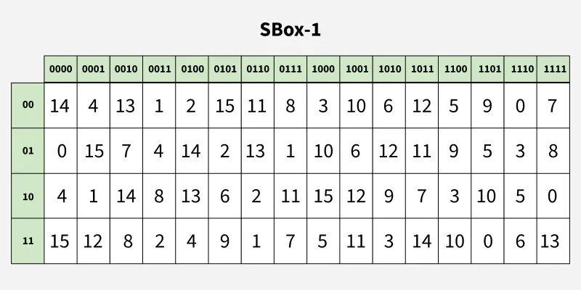

Slide 51
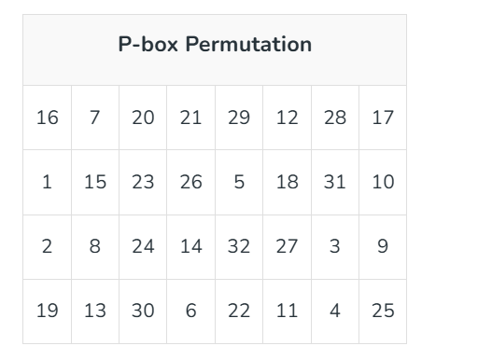

Slide 52
DES (Data Encryption Standard)
30.<number>

Slide 53
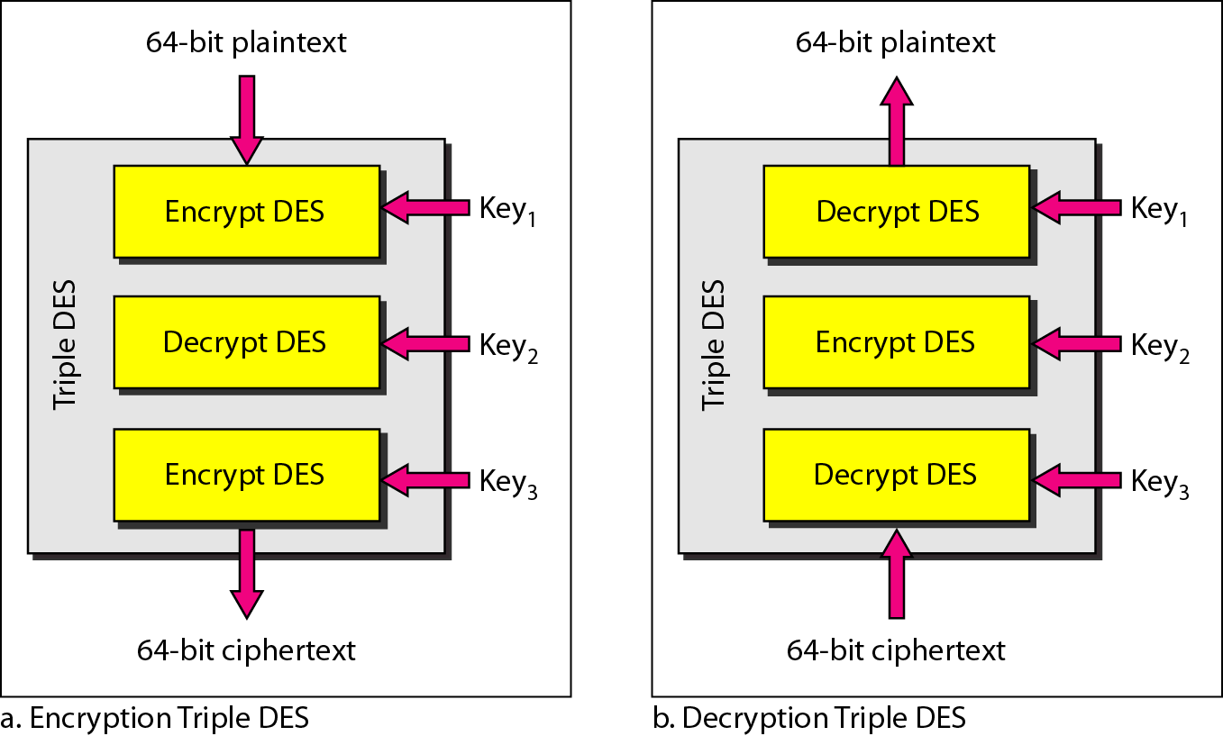
Triple DES (to resolve the short key issue for DES)
30.<number>

Slide 54
Asymmetric Encryption
Asymmetric encryption has some core differences from symmetric encryption.
The first that you can immediately notice is that in asymmetric encryption there are two keys: one public key to encrypt and a private key to decrypt.
From this concept, one of the names of asymmetric encryption is derived: public key encryption.
This approach does simplify greatly the key exchange and key management. For the key management, you only need a pair of keys (private/public) for each person. So if you have 20 people that have to communicate between themselves, you'll only need 20 pairs of keys.

Slide 55
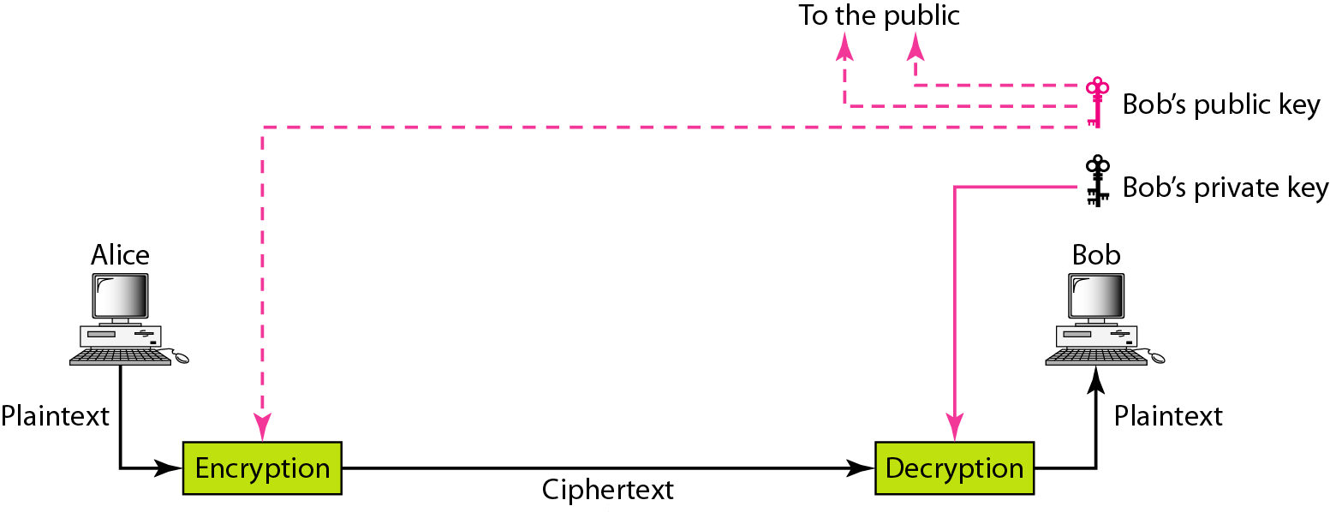
Figure 30.4 Asymmetric-key cryptography
30.<number>

Slide 56
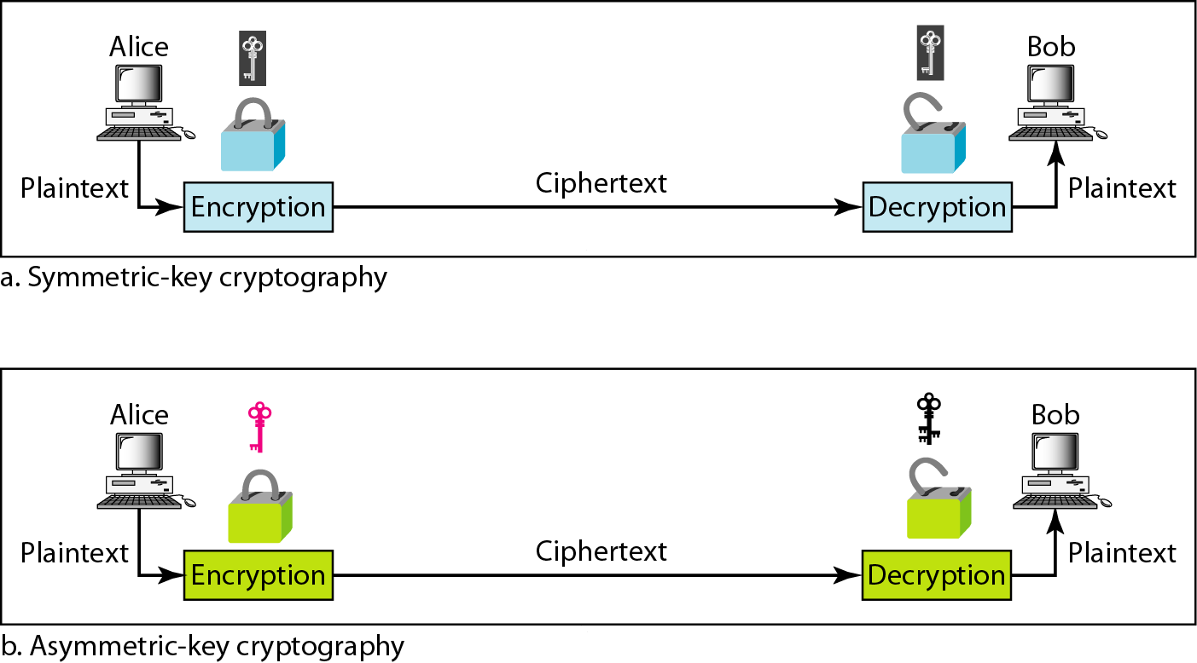
Figure 30.6 Comparison between two categories of cryptography
30.<number>

Slide 57
RSA: Choosing keys
1. Choose two large prime numbers p, q.
(e.g., 1024 bits each)
2. Compute n = pq, Φ = (p-1)(q-1)
3. Choose e (with e<n) that has no common factors
with Φ. (e, Φ are “relatively prime”).
4. Choose d such that ed-1 is exactly divisible by Φ.
(in other words: ed mod Φ = 1 ).
5. Public key is (n,e). Private key is (n,d).
+
-
K
K
B
B

Slide 58
RSA: Encryption, decryption
0. Given (n,e) and (n,d) as computed above
1. To encrypt bit pattern, m, compute
e
c = m mod n
e
(i.e., remainder when m is divided by n)
2. To decrypt received bit pattern, c, compute
d
m = c mod n
d
(i.e., remainder when c is divided by n)
Magic
happens!
e
d
m = (m mod n)
mod n
c

Slide 59
RSA example:
Let's say we choose p = 61 and q = 53.
n = p * q = 61 * 53 = 3233
(n) = (p-1)(q-1) = 60 * 52 = 3120
Let's choose e = 17 (a common choice).
d = 2753 (computed such that (17 * d) mod 3120 = 1)
So, the public key is (3233, 17), and the private key is (3233, 2753).
Encryption
To encrypt a message, the sender Uses the public key (n, e) provided by the recipient. Converts the plaintext message (m) into a ciphertext (c) using the formula −
c = m^e mod n.
Public key is (n,e). Private key is (n,d).

Slide 60
Suppose we want to encrypt the message "HELLO". We convert it to ASCII: H(72) E(69) L(76) L(76) O(79).
We will encrypt each ASCII value separately −
H: C = 72^17 mod 3233 = 2103
E: C = 69^17 mod 3233 = 2464
L: C = 76^17 mod 3233 = 2190
L: C = 76^17 mod 3233 = 2190
O: C = 79^17 mod 3233 = 875
Decryption
Once the ciphertext (c) is received, the recipient uses their private key (n, d) to decrypt the message. Computes the plaintext message (m) using the formula −
The recipient receives the ciphertext (2103, 2464, 2190, 2190, 875).
They use their private key to decrypt each value −
M = 2103^2753 mod 3233 = 72 (H)
M = 2464^2753 mod 3233 = 69 (E)
M = 2190^2753 mod 3233 = 76 (L)
M = 2190^2753 mod 3233 = 76 (L), M = 875^2753 mod 3233 = 79 (O)
d
m = c mod n

Slide 61
Step 1️⃣: Choose Two Prime Numbers
Let:𝑝=3, q=11Both are prime numbers.
Step 2️⃣: Compute n=𝑝×𝑞, n=3×11=33
👉 n = 33
This will be part of both public and private keys.
Step 3️⃣: Compute Euler’s Totient Function (φ(n))=(𝑝−1)(𝑞−1), 𝜙(33)=(3−1)(11−1)=2×10=20
👉 φ(n) = 20
Step 4️⃣: Choose Public Key (e)Choose e such that:1<𝑒<20
gcd(e, 20) = 1 Let’s choose:e=3 Because:gcd(3, 20) = 1
✅👉 Public Key = (e, n) = (3, 33)
Step 5️⃣: Find Private Key (d)
We need:𝑑×𝑒≡1(mod20) So,𝑑×3≡1(mod20)
Solve:3𝑑≡1(mod20), Try values:3×7=21≡1(mod20)
So,👉 d = 7👉 Private Key = (d, n) = (7, 33)

Slide 62
Note
In RSA, e and n are announced to the public; d and Φ are kept secret.
Public cryptography is very computational expensive.
30.<number>

Slide 63
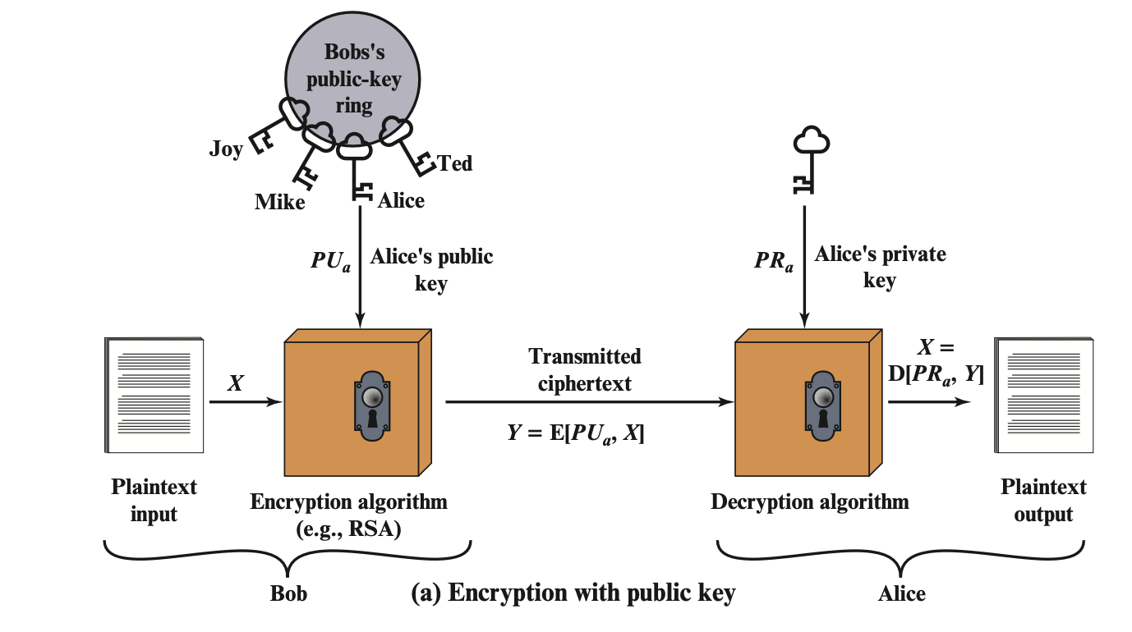
Public Key Cryptography for Encryption/Decryption

Slide 64
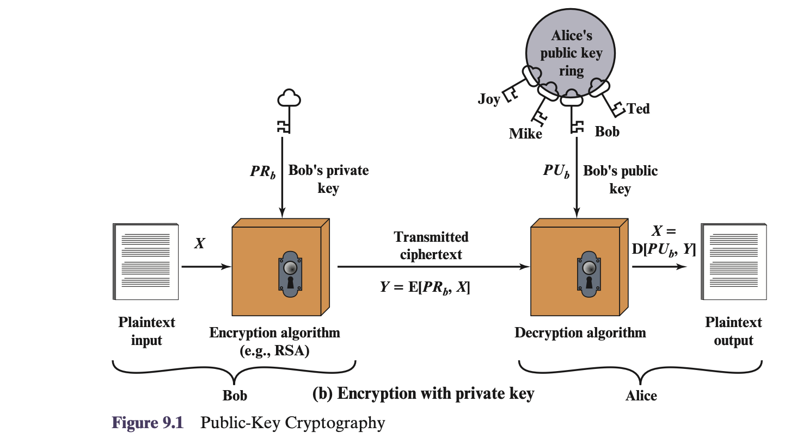
Public Key Cryptography for Digital Signatures
Demo: https://learn.pkiindia.in/asymmetric.html

Slide 65
comparison
Domain | Symmetric | Asymmetric
Able to grant | Confidential | Confidential, Offering Integrity, Authentication, and Non-repudiation
Needed keys | A single shared key | A public Key and A private Key
Key Exchange | Complex | Simple
Scalability | Not scalable, keys increase exponentially | Scalable
Key Size | small | Big
Implementation Speed | Fast | Slow
Best for | Bulk Data | Small amount of data, key exchange, digital envelopes, digital signatures and digital certificate

Slide 66
Hash Functions

Slide 67



Data Integrity and Source Authentication
Encryption does not protect data from modification by another party.
Need a way to ensure that data arrives at destination in its original form as sent by the sender and it is coming from an authenticated source.
Notes:
Modified ciphertext can often still be decrypted into plaintexts?

Slide 68
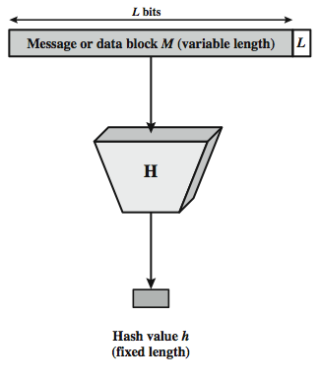

Hash Function
The hash value represents concisely the longer message
  may called the message digest
A message digest is as a ``digital fingerprint'' of the original document
condenses arbitrary message to fixed size
  h = H(M)
Notes:
A hash function H accepts a variable-length block of data M as input and produces a fixed-size hash value h = H(M). A "good" hash function has the property that the results of applying the function to a large set of inputs will produce outputs that are evenly distributed, and apparently random. In general terms, the principal object of a hash function is data integrity. A change to any bit or bits in M results, with high probability, in a change to the hash code. The kind of hash function needed for security applications is referred to as a cryptographic hash function. A cryptographic hash function is an algorithm for which it is computationally infeasible (because no attack is significantly more efficient than brute force) to find either (a) a data object that maps to a pre-specified hash result (the one-way property) or (b) two data objects that map to the same hash result (the collision-free property). Because of these characteristics, hash functions are often used to determine whether or not data has changed.
Stallings Figure 11.1 depicts the general operation of a cryptographic hash function. Typically, the input is padded out to an integer multiple of some fixed length (e.g., 1024 bits) and the padding includes the value of the length of the original message in bits. The length field is a security measure to increase the difficulty for an attacker to produce an alternative message with the same hash value.

Slide 69

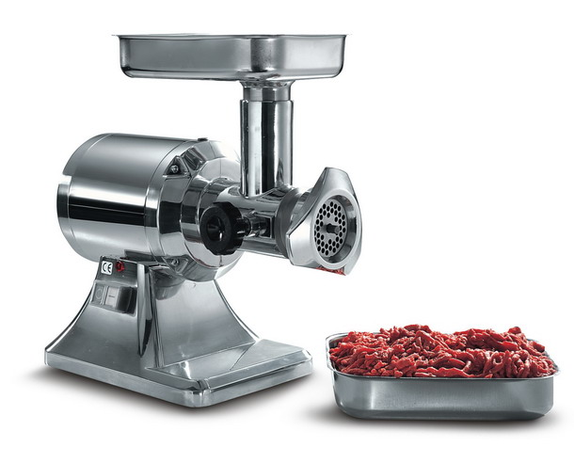
Chewing functions
Hashing function as “chewing” or “digest” function
Notes:
Hash functions, Tuma and properties.
One-wayness
First and second preimage resistance
Collision resistance
After a while he started to call them chewing functions
-->
So here we have some classic chewing functions

Slide 70

Hashing V.S. Encryption
Hello, world.
A sample sentence to show encryption.
k
E
NhbXBsZSBzZW50ZW5jZSB0byBzaG93IEVuY3J5cHRpb24KsZSBzZ
Hello, world.
A sample sentence to show encryption.
D
k
NhbXBsZSBzZW50ZW5jZSB0byBzaG93IEVuY3J5cHRpb24KsZSBzZ
  Encryption is two way, and requires a key to encrypt/decrypt
This is a clear text that can easily read without using the key. The sentence is longer than the text above.
52f21cf7c7034a20
17a21e17e061a863
  Hashing is one-way. There is no 'de-hashing’

Slide 71
Password Verification
Store Hashing Password
Verification an input password against the stored hash
Iam#4VKU
Iam#4VKU
Password store
h
h
661dce0da2bcb2d8
2884e0162acf8194
661dce0da2bcb2d8
2884e0162acf8194
661dce0da2bcb2d8
2884e0162acf8194
Hash Matching Exactly?
Password store
Yes
No
Grant
Deny

Slide 72
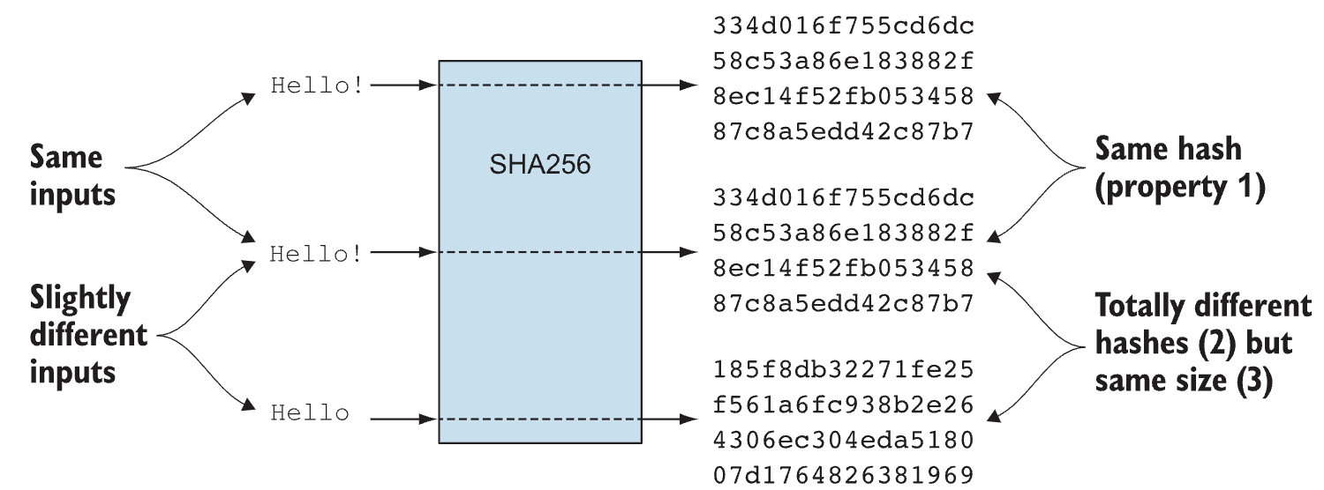

Slide 73
Hash Function Properties
Arbitrary-length message to fixed-length digest
Pre-image Resistance (One-way property)
  Given a hash h, it should be computationally infeasible to find any input x such that:
  H(x)=h
  This makes it hard to reverse a hash back to its input.
Second Pre-image Resistance
  Given an input x1​, it should be hard to find a different input x2​ such that:
  H(x1)=H(x2)
  Prevents attackers from finding alternative messages with the same hash.
Collision Resistance
  It should be very hard to find two distinct inputs x1​ and x2​ such that:
  H(x1)=H(x2)
  True collisions exist (since outputs are fixed-length), but they should be computationally unfeasible to find.
Notes:
The first properties are requirements for the practical application of a hash function. The second property, preimage (for a hash value h = H(x), we say that x is the preimage of h) resistant, is the one-way property: it is easy to generate a code given a message, but virtually impossible to generate a message given a code. This property is important if the authentication technique involves the use of a secret value The fthird property, second preimage resistant, guarantees that it is impossible to find an alternative message with the same hash value as a given message. This prevents forgery when an encrypted hash code is used. If the fouth property, collision resistant, is also satisfied, then it is referred to as a strong hash function. A strong hash function protects against an attack in which one party generates a message for another party to sign. The final requirement, pseudorandomness, has not traditionally been listed as a requirement of cryptographic hash functions, but is more or less implied.

Slide 74


Properties : Fixed length
Hello, world
661dce0da2bcb2d8
2884e0162acf8194
Fixed length L
This is a clear text that can easily read without using the key. The sentence is longer than the text above.
52f21cf7c7034a20
17a21e17e061a863
Arbitrary-length message to fixed-length digest
Demo: https://www.fileformat.info/tool/hash.htm

Slide 75
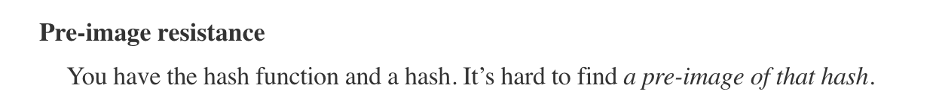
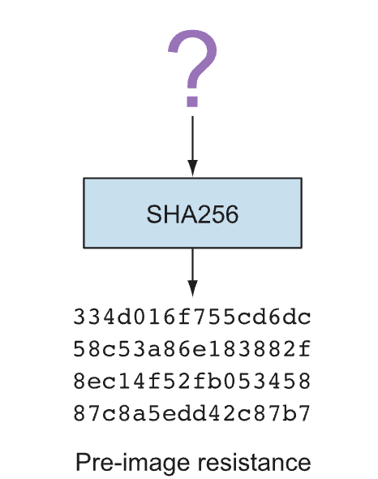
Pre-image Resistance (One-way property)
  Given a hash h, it should be computationally infeasible to find any input x such that:
  H(x)=h
  This makes it hard to reverse a hash back to its input.

Slide 76


Second Pre-image Resistance
  Given an input x1​, it should be hard to find a different input x2​ such that:
  H(x1)=H(x2)
  Prevents attackers from finding alternative messages with the same hash.

Slide 77


Collision Resistance
  It should be very hard to find two distinct inputs x1​ and x2​ such that:
  H(x1)=H(x2)
  True collisions exist (since outputs are fixed-length), but they should be computationally unfeasible to find.

Slide 78

SHA-512 Overview
Notes:
Now examine the structure of SHA-512, noting that the other versions are quite similar.
SHA-512 follows the structure depicted in Stallings Figure. The processing consists of the following steps:
• Step 1: Append padding bits, consists of a single 1-bit followed by the necessary number of 0-bits, so that its length is congruent to 896 modulo 1024
• Step 2: Append length as an (big-endian) unsigned 128-bit integer
• Step 3: Initialize hash buffer to a set of 64-bit integer constants (see text)
• Step 4: Process the message in 1024-bit (128-word) blocks, which forms the heart of the algorithm. Each round takes as input the 512-bit buffer value H_{i}, and updates the contents of that buffer.
• Step 5: Output the final state value as the resulting hash
See text for more details.

Slide 79


Padding and length field in SHA-512
What is the number of padding bits if the length of the original message is 2590 bits?
We can calculate the number of padding bits as follows:
The padding consists of one 1 followed by 353 0’s.

Slide 80

SHA-512 Round Function
Notes:
The structure of each of the 80 rounds is shown in Stallings Figure 11.10. Each 64-bit word is shuffled along one place, and in some cases manipulated using a series of simple logical functions (ANDs, NOTs, ORs, XORs, ROTates), in order to provide the avalanche & completeness properties of the hash function. The elements are:
Ch(e,f,g) = (e AND f) XOR (NOT e AND g)
Maj(a,b,c) = (a AND b) XOR (a AND c) XOR (b AND c)
∑(a) = ROTR(a,28) XOR ROTR(a,34) XOR ROTR(a,39)
∑(e) = ROTR(e,14) XOR ROTR(e,18) XOR ROTR(e,41)
+ = addition modulo 2^64
Kt = a 64-bit additive constant
Wt = a 64-bit word derived from the current 512-bit input block.
Six of the eight words of the output of the round function involve simply permutation (b, c, d, f, g, h) by means of rotation. This is indicated by shading in Figure 11.10. Only two of the output words (a, e) are generated by substitution. Word e is a function of input variables d, e, f, g, h, as well as the round word W t and the constant Kt. Word a is a function of all of the input variables, as well as the round word W t and the constant Kt.

Slide 81

Some well-known hash functions

Slide 82
Patterns of Hashing Data
Independent hashing
Repeated hashing
Combined hashing
Sequential hashing
Hierarchical hashing
Courtesy: Blockchain Basics: A Non-Technical Introduction in 25 Steps by Daniel Drescher

Slide 83


Types of Hashing
Independent hashing
Repeated hashing

Slide 84


Types of Hashing
Combined hashing
Sequential hashing

Slide 85

Types of Hashing
Hierarchical hashing

Slide 86

Digital Signatures

Slide 87


Digital Signature

Slide 88
Digital Signature
A digital signature needs a public-key system. The signer signs with her private key; the verifier verifies with the signer’s public key.
A cryptosystem uses the public and private keys of the receiver; a digital signature uses the private and public keys of the sender.

Slide 89

Digital Signatures

Slide 90

Digital Signatures

Slide 91

Digital Signatures

Slide 92

Digital Signatures

Slide 93
Demo
https://learn.pkiindia.in/index.html

